Slide 1

Introduction to R
Dustin Elery
Senior Analytics Consultant

Slide 2
Agenda
A little about me
What is R?
General Overview of R Studio Environment
Microsoft SQL Server R Services Review
Demo’s
Import Data
Data Munging/Wrangling
Basic Exploration/Visualization
Basic Predictive Analysis
Questions?
Notes:
10 mins / 10

Slide 3
A Little About Me
Business Intelligence – 5 years
New to R
Specialize in Tableau as a reporting tool
Strong SQL Server and Data Warehousing background
Passion for Statistics and Finance
MBA from Kelly School of Business
Live in Indy
Love consulting
Constant challenge
Varying technology
Ability to play in the now while levering strengths
Notes:
30 mins/40

Slide 4

What is R?
R is a language and environment for statistical computing and graphics.
R-project.org
R is available as Free Software under the terms of the Free Software Foundation’s GNU General Public License in source code form
“Many users think of R as a statistics system. We prefer to think of it of an environment within which statistical techniques are implemented.”
The R environment
R is an integrated suite of software facilities for data manipulation, calculation and graphical display. It includes:
data handling and storage facility
integrated collection of intermediate tools for data analysis
graphical facilities for data analysis and display either on-screen or on hardcopy
programming language which includes conditionals, loops, user-defined recursive functions and input and output facilities.
Notes:
10 mins / 10

Slide 5

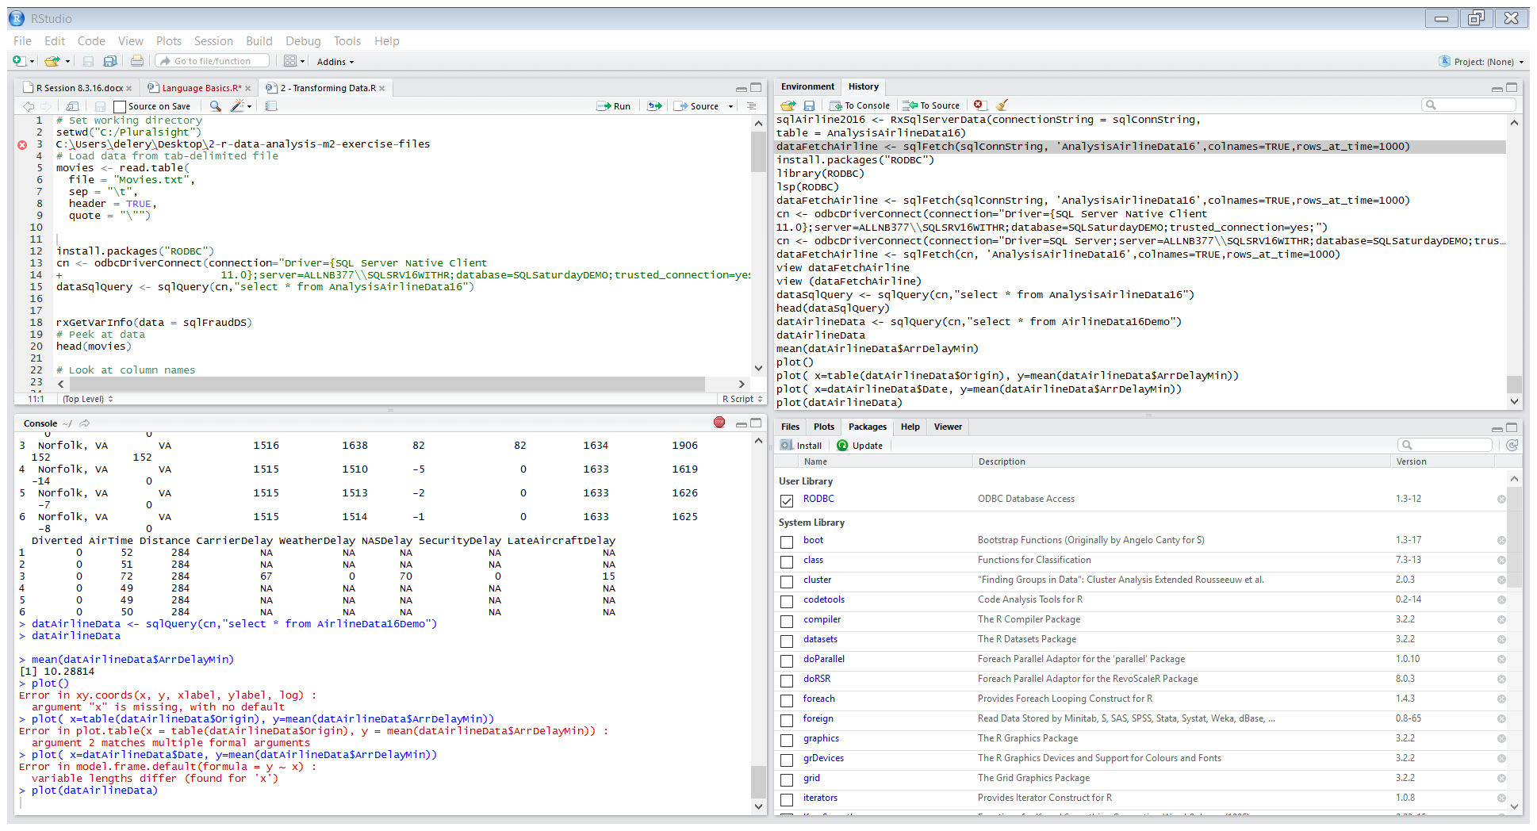
R Studio -
https://www.rstudio.com/home/
Integrated Development Environment – user friendly
4 Panes
Source – scripting
Console – interactive, type commands, execute
Environment – state of variables
Misc. – files, visual, packages, help, etc.
I will review closer in the demo

Slide 6
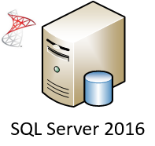
SQL Server R Services
Scale analysis to billions of records
without additional hardware
Avoid unnecessary data movements
Put R code into production without having to re-write it in another language
Leverage the power of SQL Server
using features such as the in-memory database engine and columnstore indexes.
Notes:
10 mins / 10

Slide 7
SQL Server R Service
Providing ease of use Advanced Analytics in a familiar environment
Development
R IDE or MSFT R Client, execute on SQL Server, pass results back to application
Optimization
ScaleR and RevoScaleR
Deployment
Stored procedures
Management and Monitoring
User control, storage

Slide 8
Common R Uses
Data Wrangling and Preparation
Data Exploration
descriptive and summary statistics
Visualization
Statistical Analysis
Open source, free packages for just about everything
https://cran.r-project.org/web/packages/

Slide 9
R Studio and SQL Server 2016 DEMO
R Studio in Action
Airline Data
Run through loading and mining the data
Wrangling
Descriptive
Visual
Predict
Notes:
10 mins / 10

Slide 10
Demo – R
Data Source: Bureau of Transportation Statistics
http://www.transtats.bts.gov/DL_SelectFields.asp?Table_ID=236&DB_Short_Name=On-Time
CSV files
Pulled copies into SQL Server 2016, data cleaning
Could be done in R, more proficient in SQL
Demo CSV and SQL sources in script
Start Demo

Slide 11

Questions?

Slide 12
Back up slides

Slide 13
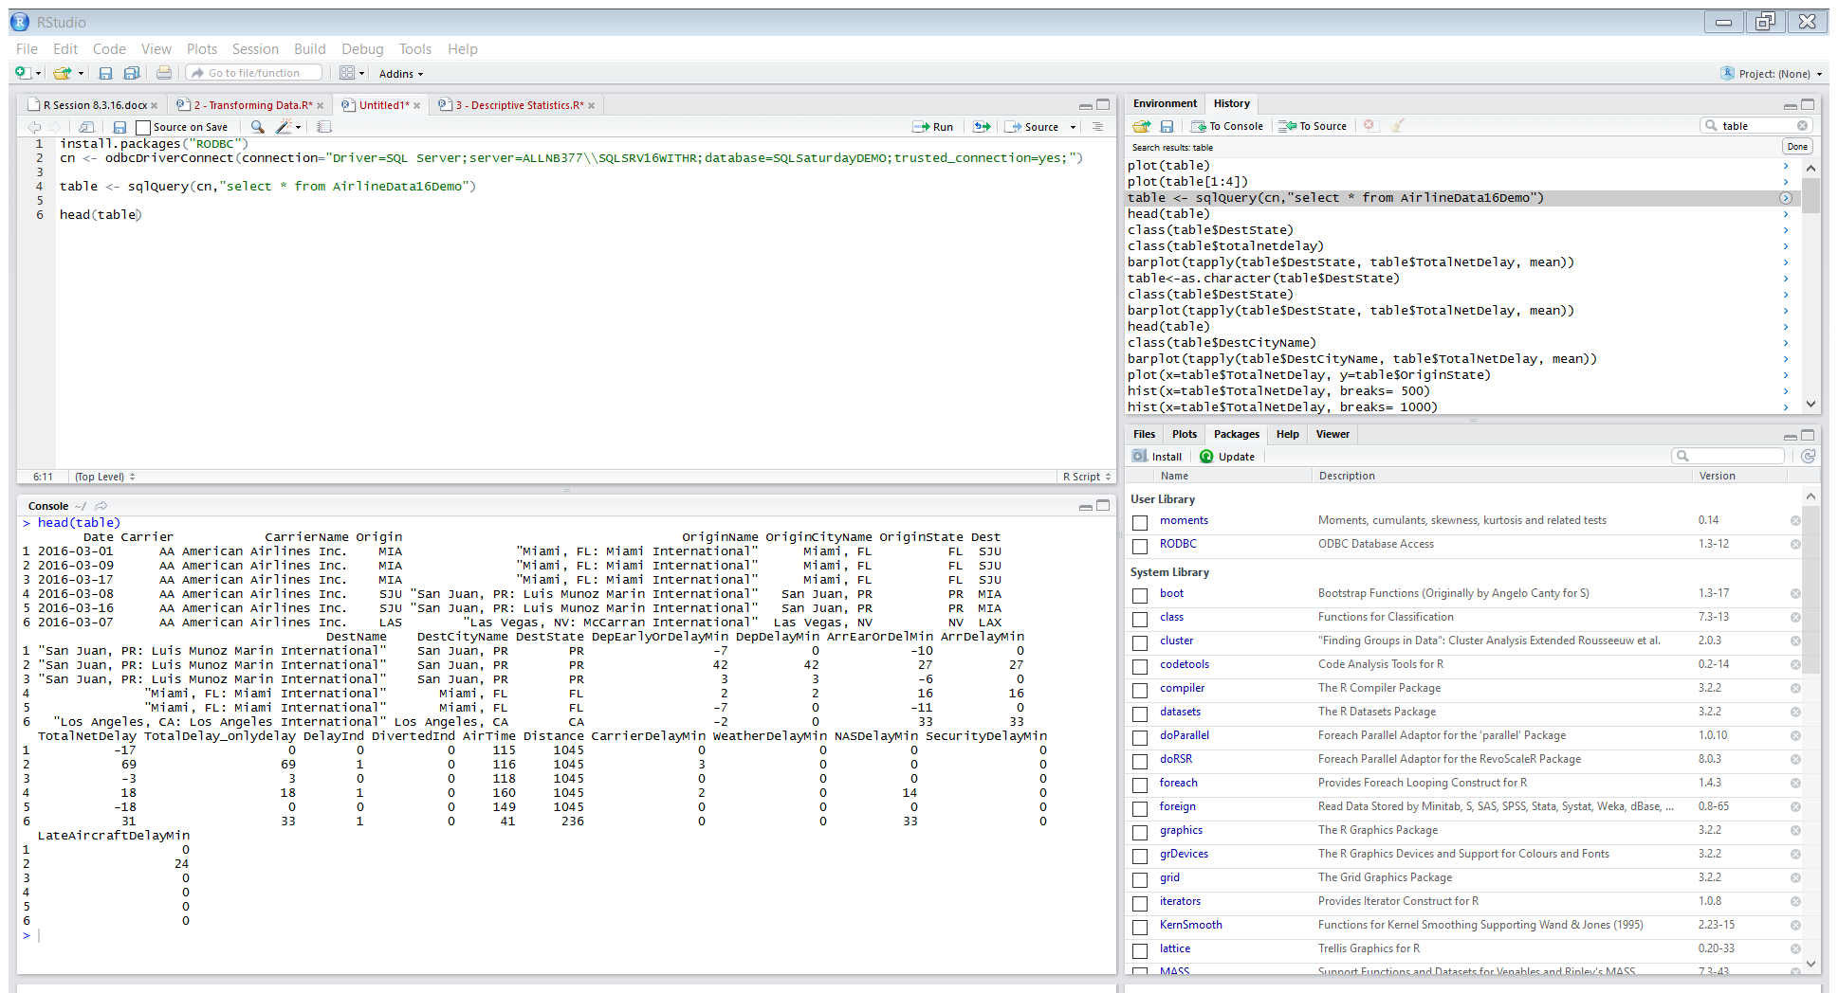
R Studio – create connection, load data, view it

Slide 14
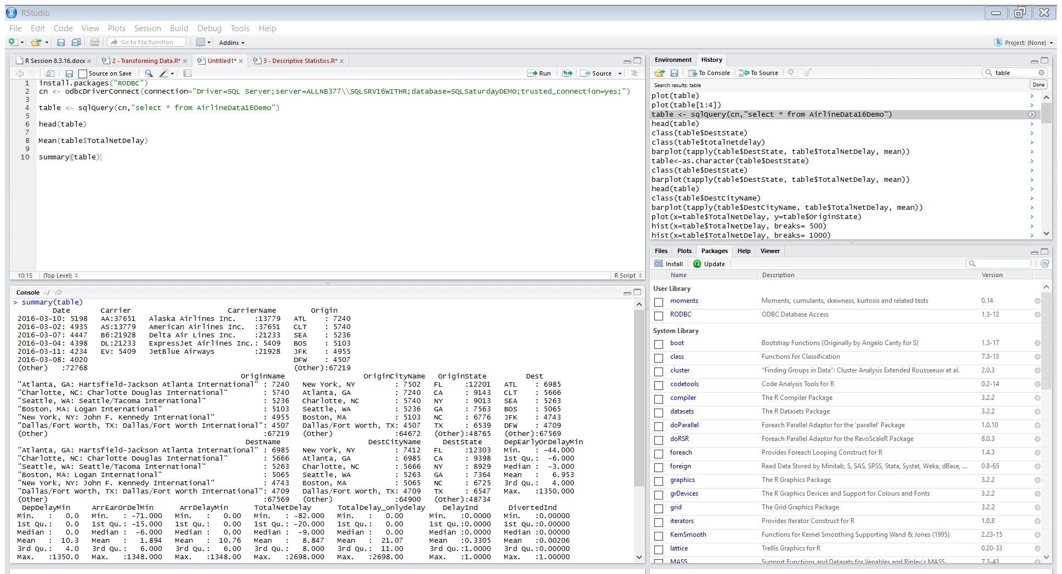
Descriptive Stats

Slide 15
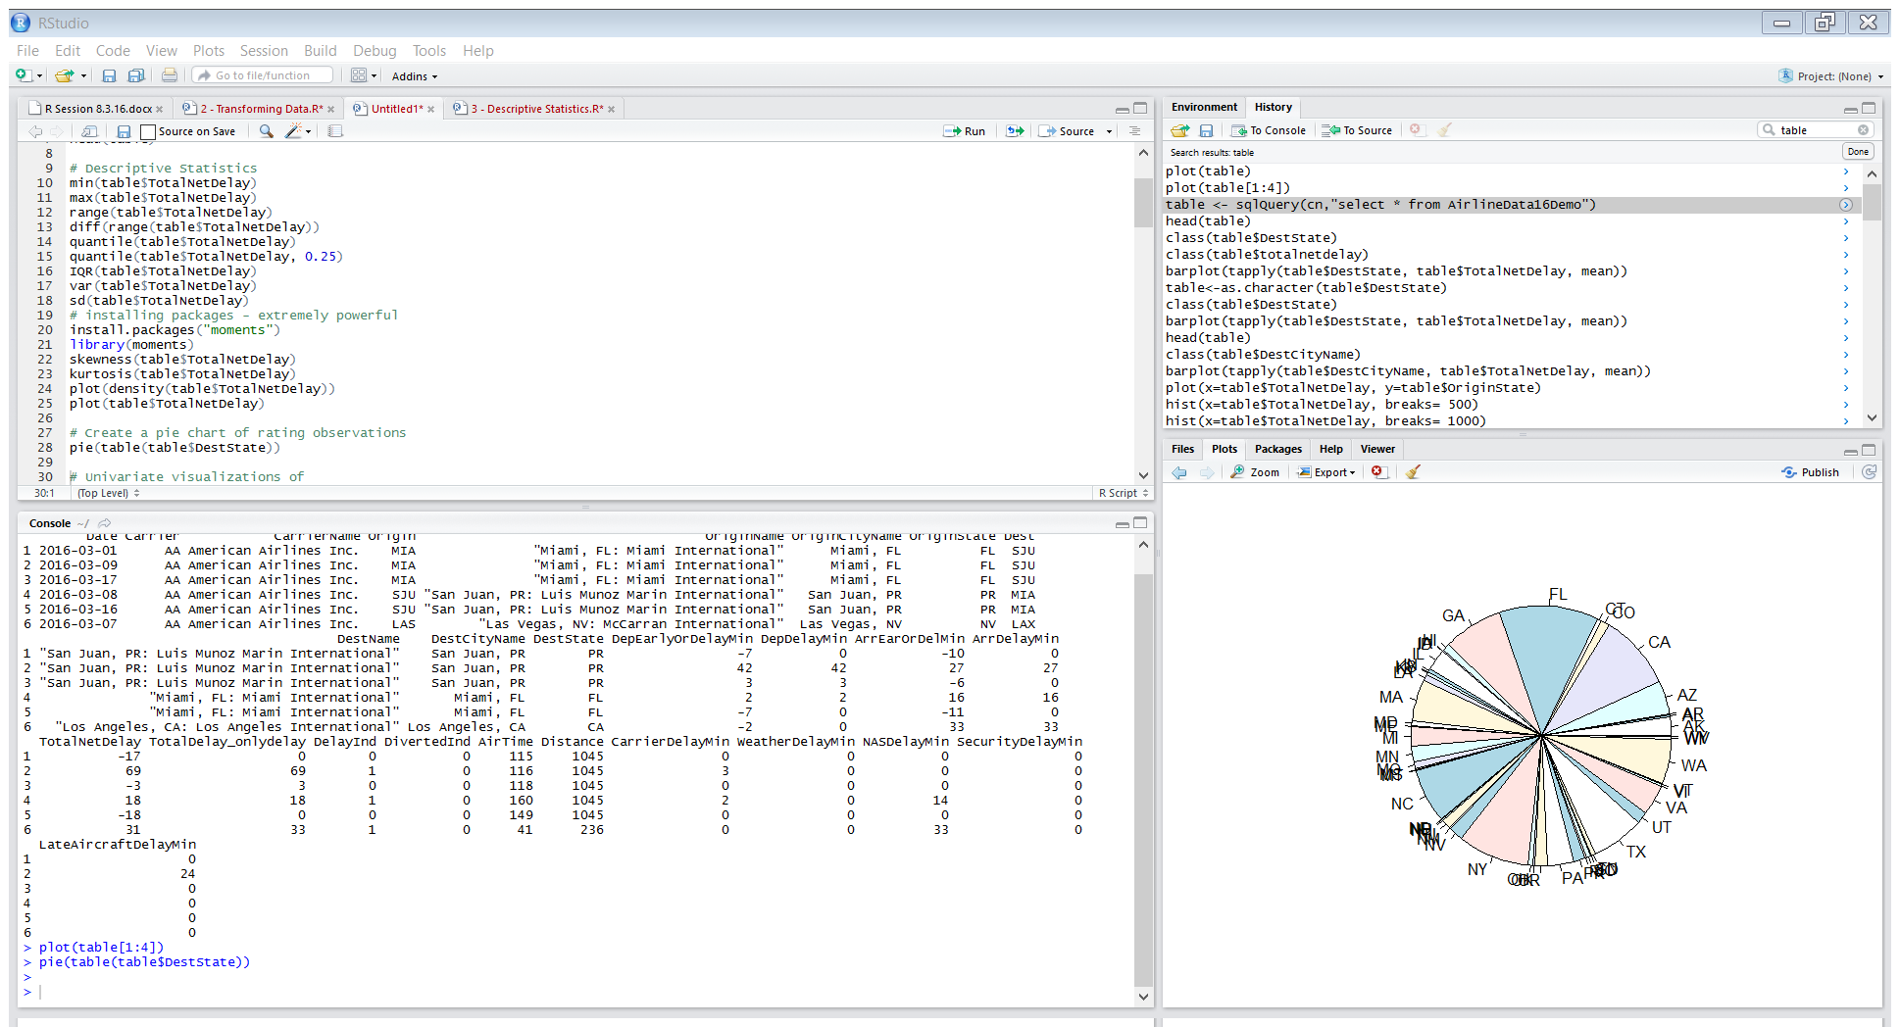
Plotting

Slide 16
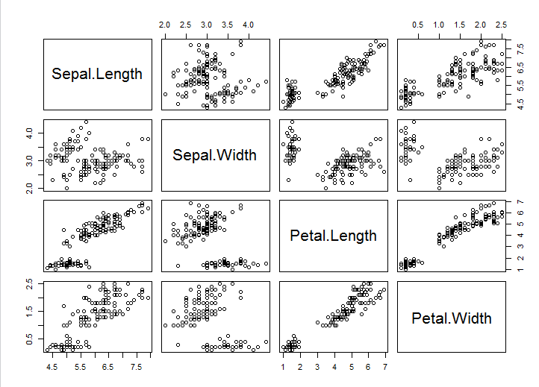
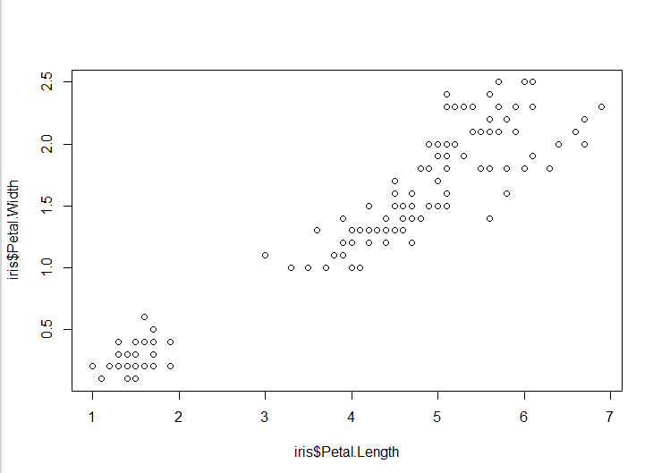
Exploration

Slide 17
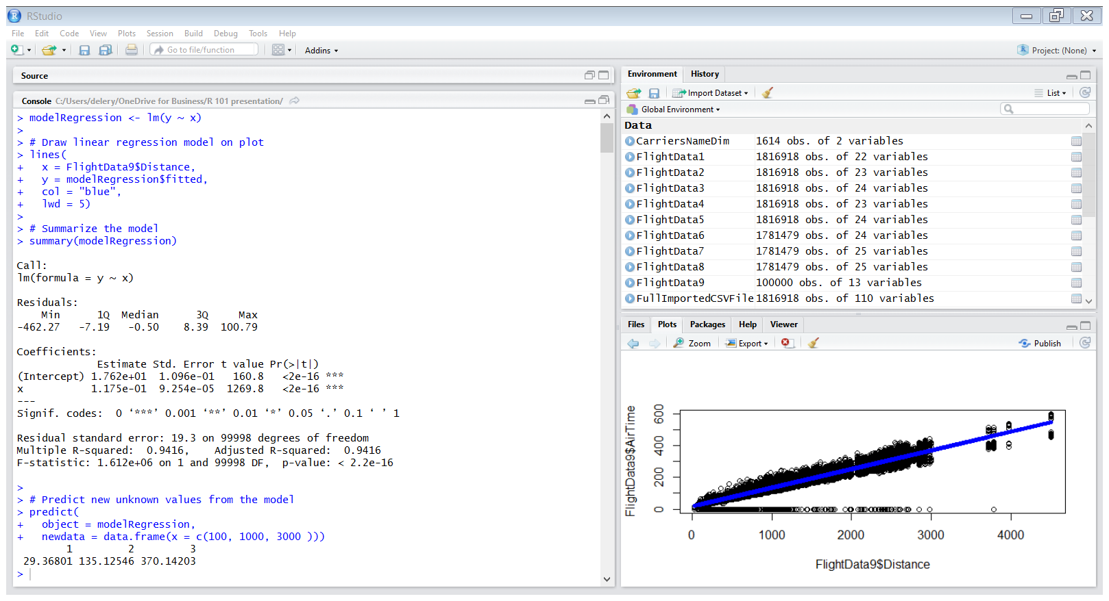
Regression

Slide 18
Resources Used
R Studio
https://www.rstudio.com/resources/cheatsheets/
https://vimeo.com/130411487
R- project
SQL Server 2016
Alteryx
Pluralsight
DataCamp
Find links, notes, scripts, etc. on what I used for this in back up slides

Slide 19
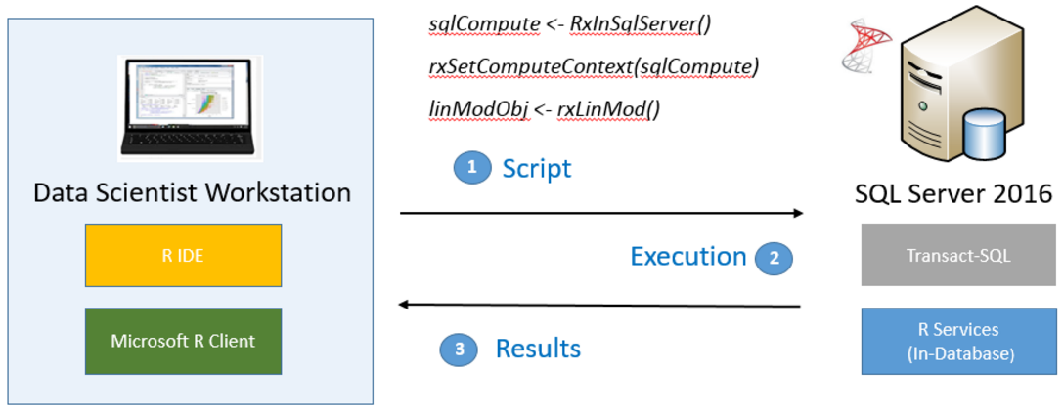
SQL Server R - Development

Slide 20
SQL Server R - Optimize
Leverage your database instead of just your machine
ScaleR
The RevoScaleR package has some of the most popular R functions, redesigned to provide parallelism and scale.
The package also includes functions that further boost performance and scale by pushing computations to the SQL Server computer
multi-threaded, multi-core, multi-process computation.

Slide 21
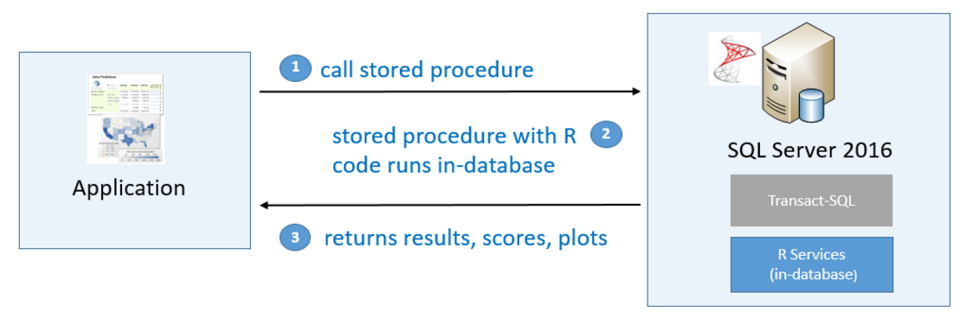
SQL Server R - Deployment
Storing and running R code from SQL Server
Use T-SQL interface
Avoid extra data movement. You can use Transact-SQL to generate scores from a predictive model in production, or return plots generated by R and present them in an application such as Reporting Services.

Slide 22
SQL Server R – Manage and Control
isolates R sessions
Control users who can run R scripts and what databases can be accessed by R code
Control the amount of resources allocated to the R runtime
Control and audit the data used by analysts
Schedule jobs and author workflows containing R scripts using stored procedures.

